Slide 1

Predicting Medical Insurance Cost Using Machine Learning
Aswin ABRAHAM NeBU

Slide 2
Project Overview
The goal of this project is to predict medical insurance costs for individuals using machine learning algorithms. The predictions are based on demographic and lifestyle factors such as age, gender, BMI, smoking status, number of children, and residential region. Accurate predictions help:
- Insurance companies create better pricing strategies.
- Reduce underpricing/overpricing risks.
- Encourage healthier lifestyles.

Slide 3
Problem Statement
Medical insurance costs are influenced by multiple factors, which interact in complex ways. Traditional linear methods may not capture these relationships effectively.
Challenge: Build a predictive model using machine learning to accurately estimate insurance charges.

Slide 4
Objectives
The objectives are:
1. Perform Exploratory Data Analysis (EDA).
2. Preprocess the data for machine learning models.
3. Build and evaluate:
- Linear Regression
- Random Forest Regressor
- XGBoost Regressor
4. Identify the most influential features.
5. Provide actionable insights.

Slide 5
Dataset Overview
The dataset contains 1338 rows and 7 features, with the target variable being 'charges’.
age: Age of the individual.
sex: Gender: male/female.
bmi Body Mass Index.
children: Number of dependents.
smoker: Smoking status.
region: Residential region.
charges: Insurance cost.

Slide 6
Exploratory Data Analysis (EDA)
1. Distribution of Features:
- Age: Most individuals are aged between 18-65.
- BMI: Normally distributed with an average of ~30.
- Charges: Right-skewed.
2. Relationships with Target:
- Age vs Charges
- BMI vs Charges
- Smoker Status vs Charges.

Slide 7
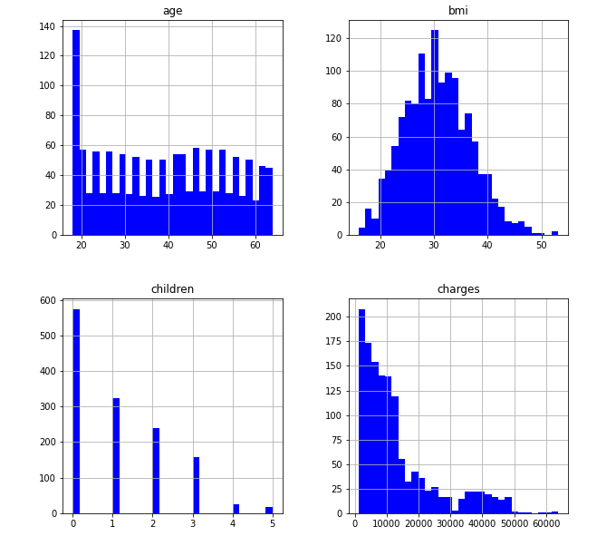

Slide 8
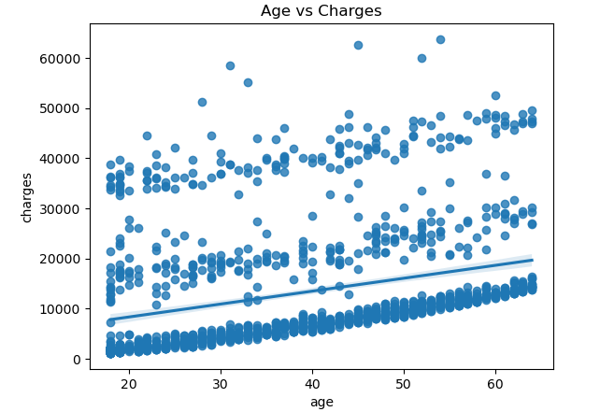

Slide 9
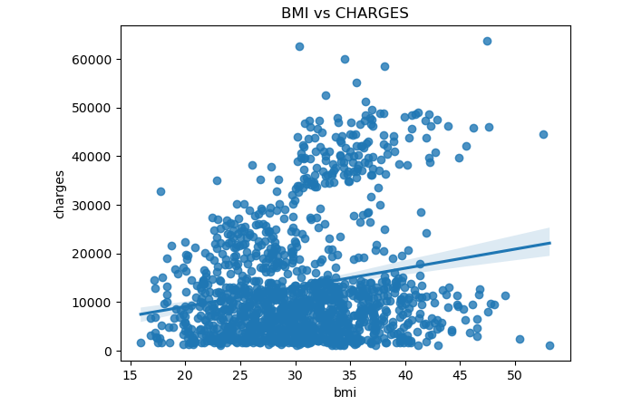

Slide 10
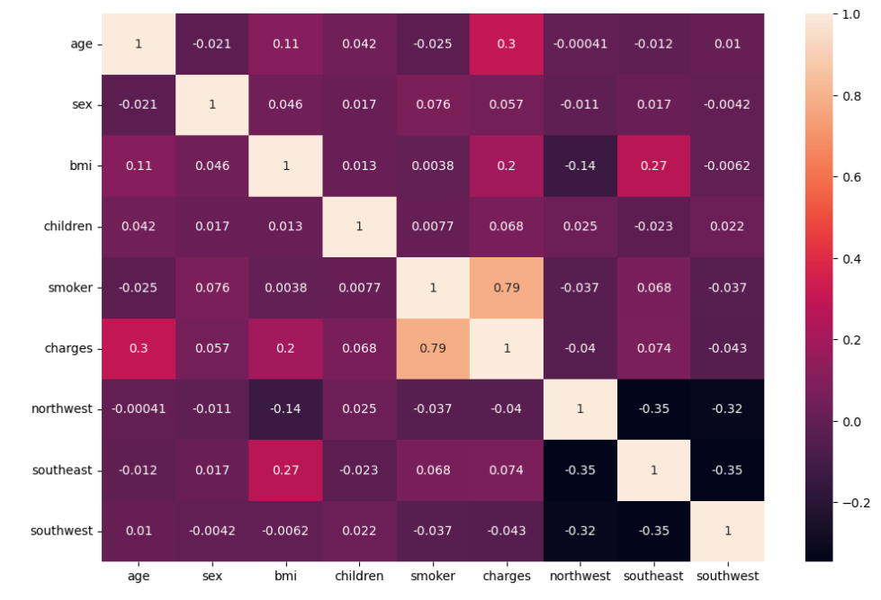
Heat MAP

Slide 11
Model Development
Three machine learning models were developed:
- Linear Regression: Baseline model.
- Random Forest Regressor: Captures non-linear relationships.
- XGBoost Regressor: Optimized for better accuracy.

Slide 12
Model Evaluation
Models were evaluated using R², RMSE, and MAE:
| Model | R² Score | RMSE | MAE |
| Linear Regression | 0.727 | 6092.00 | 4186.90 |
| Random Forest | 0.898 | 4030.56 | 2781.29 |
| XGBoost Regressor | 0.920 | 3876.21 | 2546.78 |
XGBoost Regressor achieved the best performance.

Slide 13
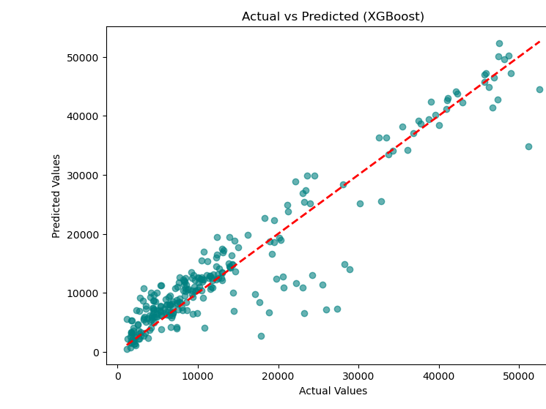

Slide 14
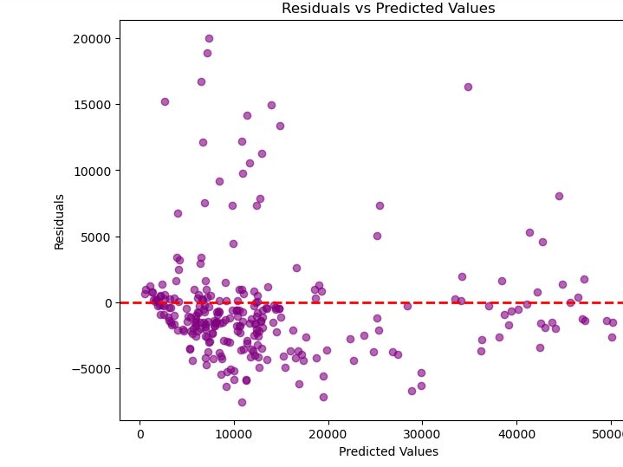

Slide 15
Feature Importance
The XGBoost model identified the most important features:
1.Smoker: Most significant.
2. BMI: Higher BMI increases costs.
3. Age: Older individuals incur higher costs.
These insights help optimize strategies.

Slide 16
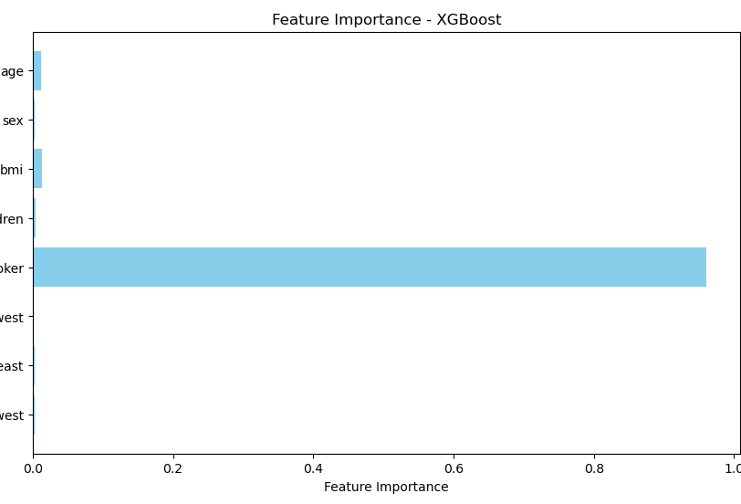

Slide 17
Conclusion
The project successfully predicted medical insurance costs using machine learning:
-XGBoost Regressor achieved an R² score of 0.92.
-Smoking status is the strongest predictor.
- BMI and Age are also significant features.
Insurance companies can use these findings to optimize pricing strategies and promote healthier behaviors.

Slide 18
THANK YOU

